Slide 1
Recommendation of Wikipedia articles
By Raksha Kaverappa

Slide 2
Steps involved
Parsing Wikipedia dumps using beautiful Soup
Parsing XML pages using SAX parser
Extracting information from XML using mwparserfromhell
Using multiprocessing to extract information in parallel
Embed the extracted information using Neural network embedding and find the cosine similarity between the articles
Recommend articles based on Cosine Similarity

Slide 3
Parsing Wiki pages
The Wiki dumps are available at : dumps.wikimedia.org/enwiki
Extract the wiki pages (15GB partitioned, 58GB uncompressed) using BeautifulSoup
We will use Keras.utils to parse through the pages

Slide 4
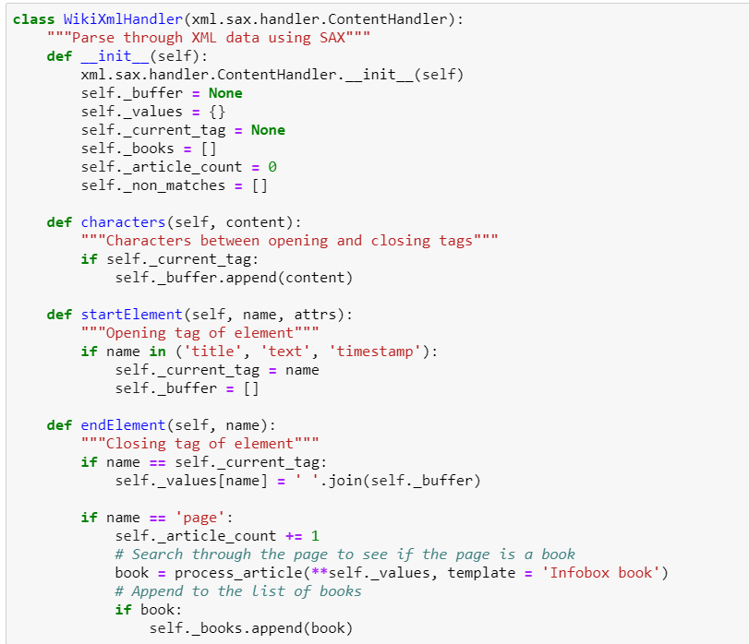
Parsing XML using SAX parser

Slide 5
Multiprocessing
We use multiprocessing to parse through the pages in parallel.
My CPU has 4 processors. The total time for processing was close to 16 hours

Slide 6
Neural Network Embedding
We will use Keras embedding layer to create an embedding space
Place similar books close to one another to make recommendations

Slide 7
Thank you..

